Slide 1
FACE RECOGNITION WITH LOCAL BINARY PATTERNS
- live video implementation
N150525-B.Ramesh
N150678-Y.Vinod
Under the guidance of Mr.Udaya Kumar Ambati
Assistant Professor Dept. of CSE
RGUKT IIIT NUZVID

Slide 2
Outline
Abstract
Introduction
Face Recognition
Existing Algorithms
Proposed Algorithms
Local Binary Pattern LBP
Identification Process
Data Set
Experimental Procedure
Results
Conclusion
Future Scope
Reference

Slide 3
Abstract
The face of a human being conveys a lot of information about the identity and emotional state of the person.
Face recognition is an interesting and challenging problem.
Areas such as identification for law enforcement, authentication for banking and security system access, and personal identification among others.
Our work mainly consists of three parts, namely face representation, feature extraction and classification. We implemented this using LBP.

Slide 4
Introduction
Face representation represents how to model a face and determines the successive algorithms of detection and recognition.
The human ability to recognize faces is remarkable.
Modern Civilization heavily depends on person authentication for several purposes.

Slide 5
Face Recognition
A facial recognition system is a technology capable of identifying or verifying a person from a digital Image or a video frame from a video source.
There are multiple methods in which facial recognition systems work, but in general, they work by comparing selected facial features from given image with faces within a database.

Slide 6
The face recognition systems can operate basically in two modes:
Verification or authentication of a facial image: it basically compares the input facial image with the facial image related to the user which is requiring the authentication. It is basically a 1x1 comparison.
Identification or facial recognition: it basically compares the input facial image with all facial images from a dataset with the aim to find the user that matches that face. It is basically a 1xN comparison.

Slide 7
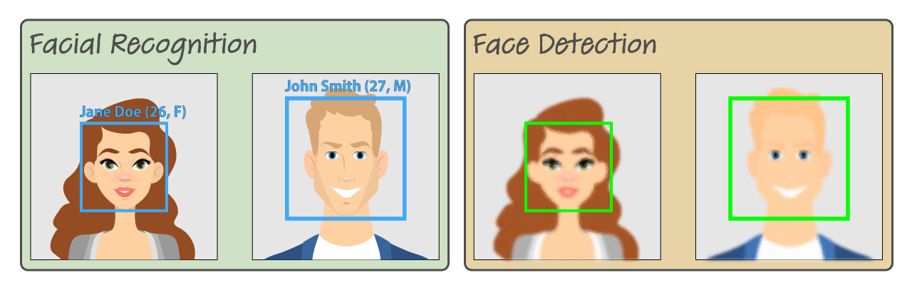
Fig-1.0

Slide 8
Existing Algorithms
Among the major approaches developed for face recognition are :
Eigenfaces,
Fisherfaces,and
Template Matching

Slide 9
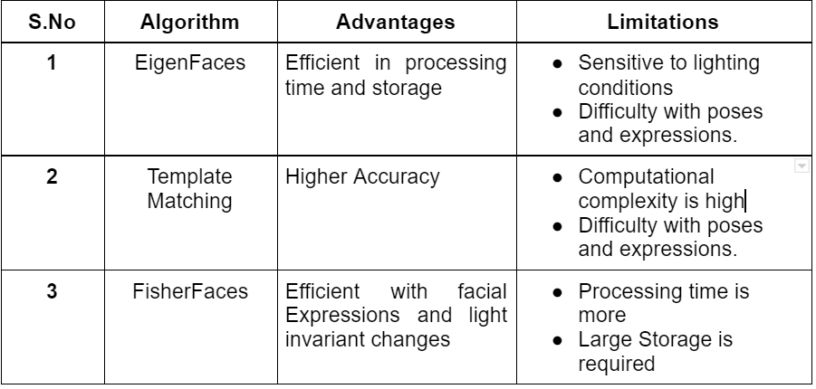
Summary Of Algorithms :

Slide 10
Proposed Algorithms
We used a different approach for face recognition which considers both shape and texture information to represent the face images ie., Local Binary Patterns(LBPs).
The face image is first divided into small regions from which the LBP features are extracted and concatenated into a single feature histogram efficiently representing the face image.

Slide 11
The textures of the facial regions are locally encoded by the LBP patterns while the whole shape of the face is recovered by the construction of the face feature histogram.
The idea behind using the LBP features is that the face images can be seen as composition of micro-patterns which are invariant with respect to monotonic grey scale transformations.
Combining these micro-patterns,a global description of the Face image is obtained.

Slide 12
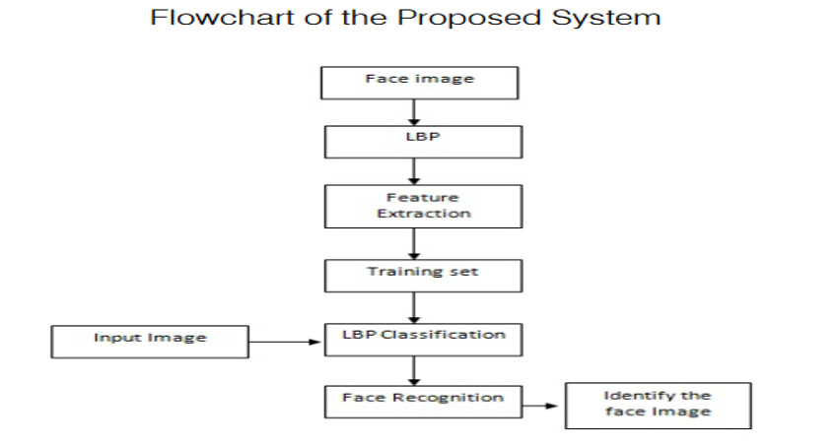
Figure 1.1

Slide 13
Feature Extraction :
The most useful and unique features (properties like eyes,eyebrows,nose,mouth,etc,.) of the face image are extracted.
Classification :
The output of the classification part is to identity a face image from the database with the highest matching score,thus with the smallest differences compared to the input face image.

Slide 14
Local Binary Pattern LBP
Take a 3x3 window and move it one image, at each move (each local part of an image), compare the pixel at the center with its neighbor pixels.
The neighbors with intensity value greater than or equal to center pixel are denoted by 1 and others by 0.
Then you read these 0/1 values under 3x3 window in a clockwise order and you will have a binary pattern like 11100011 and this pattern is local to a specific area of the image

Slide 15
cont..
You do this on whole image and you will have a list of local binary patterns.
You convert each binary pattern into a decimal number using binary to decimal conversion and then you make a histogram of all of those decimal values.
So in the end you will have one histogram for each face image in the training data set.
That means if there were 100 images in training data set then LBPH will extract 100 histograms after training and store them for later recognition.
Remember, algorithm also keeps track of which histogram belongs to which person.

Slide 16

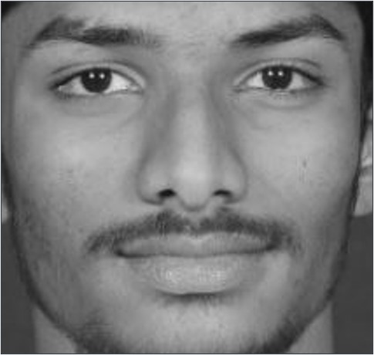
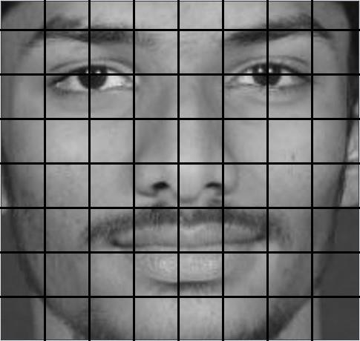
Figure 1.2: A preprocessed image divided into 64 regions

Slide 17
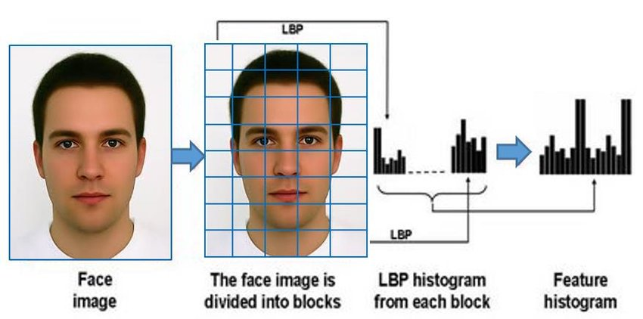
Figure 1.3

Slide 18
How LBP values are Calculated:
P=1
LBP R,P =∑ s ( gp - gc ) . 2P
p=0
Where neighborhood pixels(gp) in each block is thresholded by its center pixel value(gc)
P - Sampling points (p=0,1,2,3,4,5,6,7 for a 3*3 cell , where p = 8)
R - Radius (for a 3*3 cell , it is 1)
Binary threshold function s(x) is,
s(x) = { 0 , x < 0
{ 1, x>=0

Slide 19
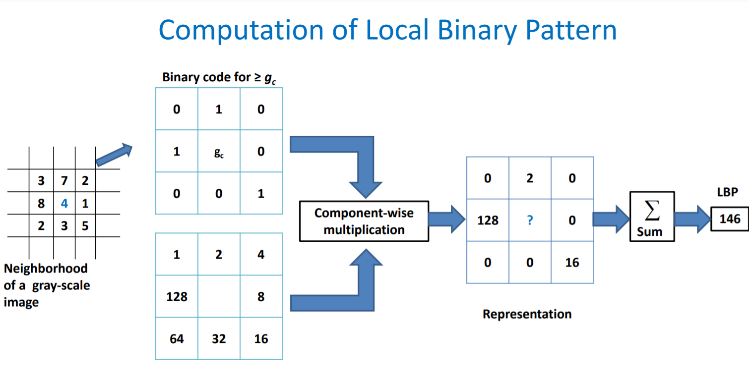

Slide 20
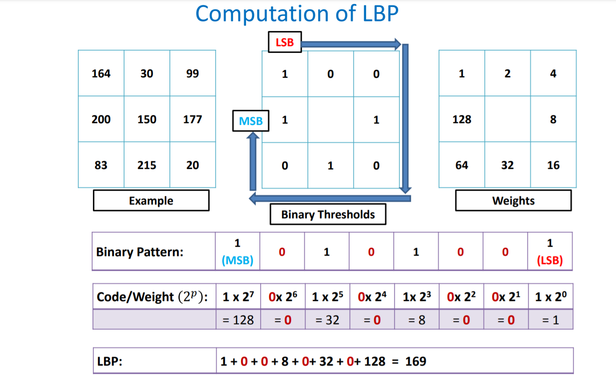

Slide 21
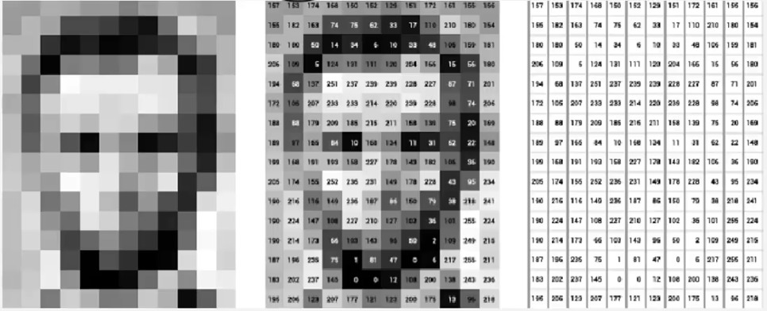
Figure 1.4 : How LBP works

Slide 22
Data Set
Testing Set: This set is used as a gallery set, contains frontal images of people.
Training Set: The subjects were asked for an alternative facial expression than in a photograph.

Slide 23
Experimental Procedure
1. Place some test images in TestImages folder that you want to predict in tester.py file
2. Place Images for training the classifier in training Images folder.If you want to train classifier to recognize multiple people then add each person's folder in separate label markes as 0,1,2,etc and then add their names along with labels in tester.py/videoTester.py file in 'name' variable.
3.To do test run via tester.py give the path of image in test_img variable
4.Use tester.py to predict the faces via webcam.

Slide 24
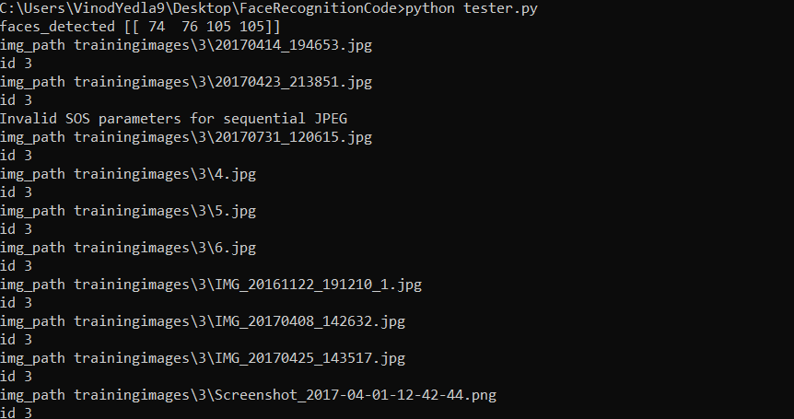
Results :

Slide 25
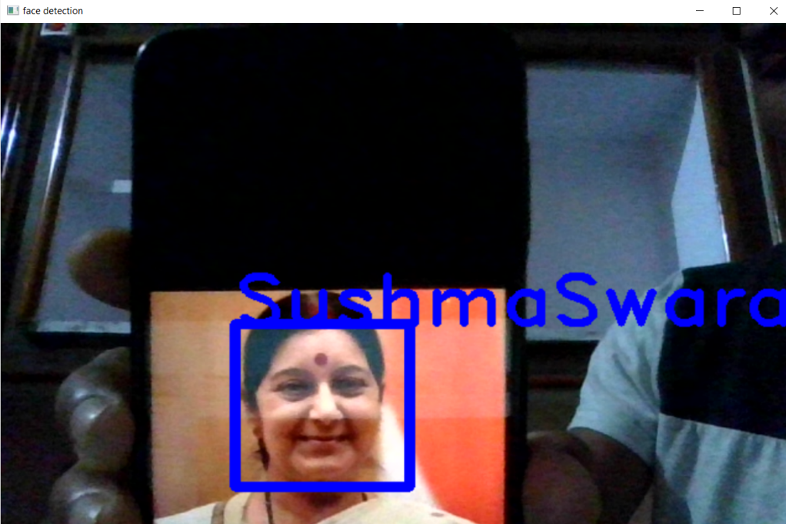
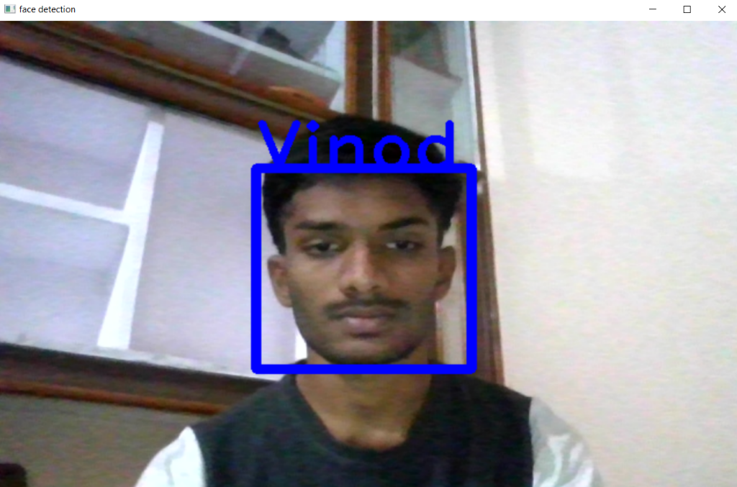

Slide 26
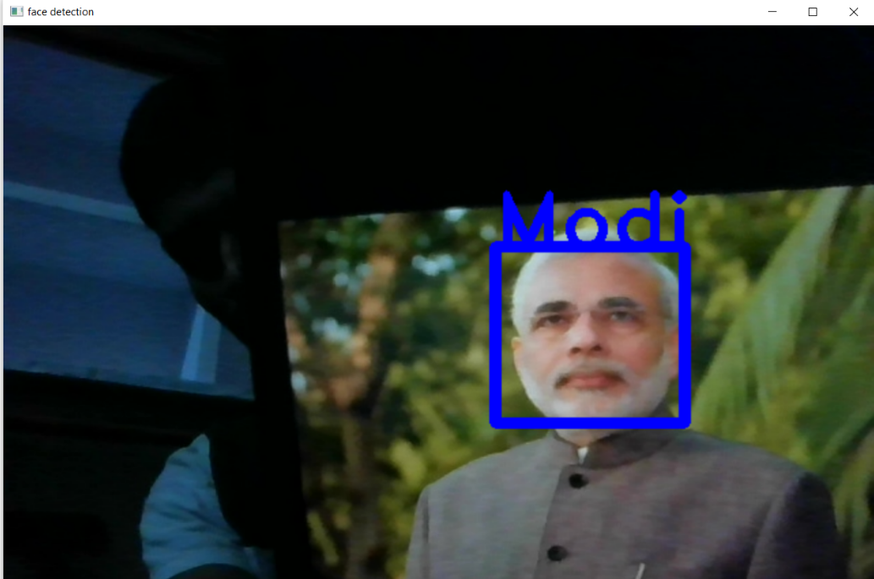

Slide 27
Advantages Of LBP:
LBP is more effective in conditions like light or illumination changing effect in an image than eigenFaces and Fishers Algorithm.
Good Performance
Computational simplicity
Limitations Of LBP:
Not invariant to rotations
Produces long histograms,which can slow down recognition speed,especially on large training databases

Slide 28
Conclusion
It has been done to the performance of a face recognition system by making use of feature extraction with Local Binary Patterns.
The accuracy of the system is above 90% by the Local Binary Pattern.
How the training of images is done and the model has detected the face and labeled it accordingly.

Slide 29
Future Scope
It is a major research area because of the broad choice of applications in the fields of commercial and law enforcement. In future with more dataset we can increase the accuracy of the project and make it available to daily life usage.

Slide 30
Reference
http://www.ee.oulu.fi/mvg/

Slide 31


